Slide 1
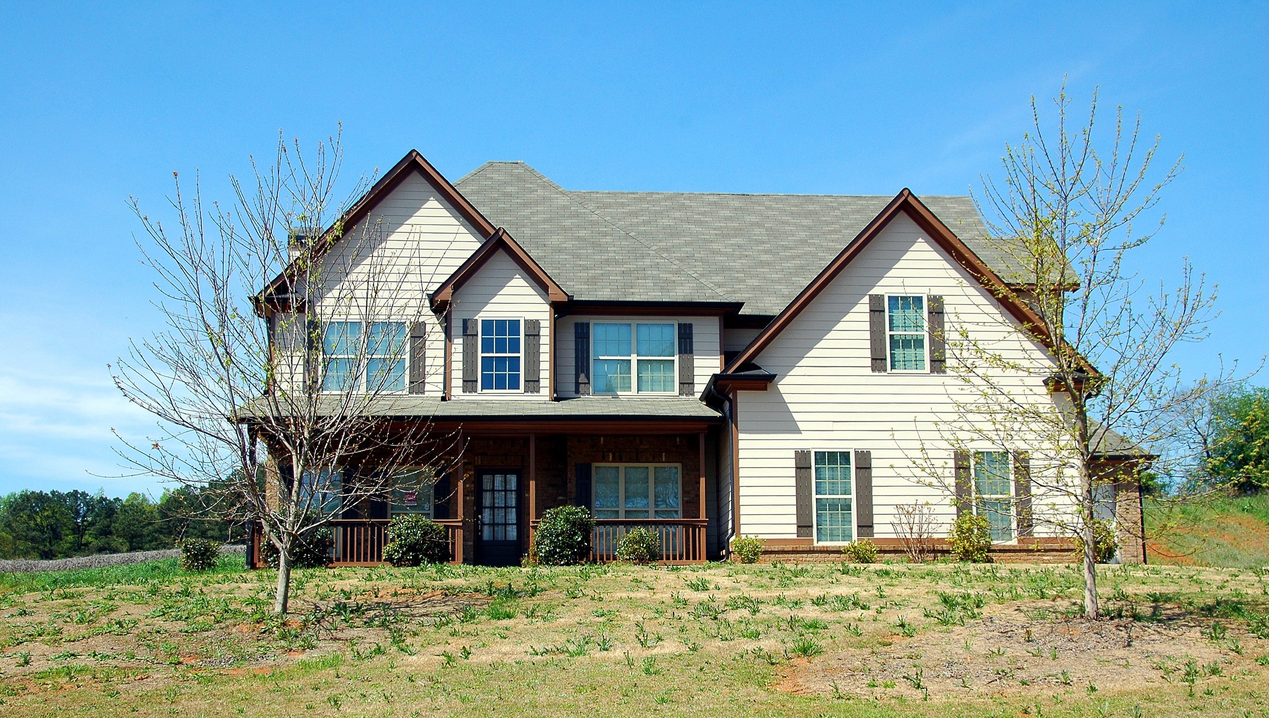
Temperature
Inside: 22°C
Outside: 13°C
Water Consumption
Today: 220 ltr.
This month: 2.5 m3
This year: 33.2 m3

